Slide 1


Face Recognition Based Attendance Management System
Suryansh Baranwal
Priyam Gupta

Slide 2
INTRODUCTION -
Attendance plays an important role in any organisation whether it be educational institutions or companies. So it is very important to keep record of the attendance. The problem arises when one has to manually take the attendance which is not only time consuming but exhausting as well. So an automatic attendance system can solve such problem.
Basically, there are two kinds of system:
1) Manual Attendance System (MAS)
2) Automated Attendance System (AAS)
We used a method invented in 2005 called Histogram of Oriented Gradients (HOG) for face detection. For identifying the name of person simple linear SVM Classifier is used. All we need to do is train a classifier that can take in the measurements from a new test image and tells which known person is the closest match. The result is the name of person which is used to mark attendance.

Slide 3
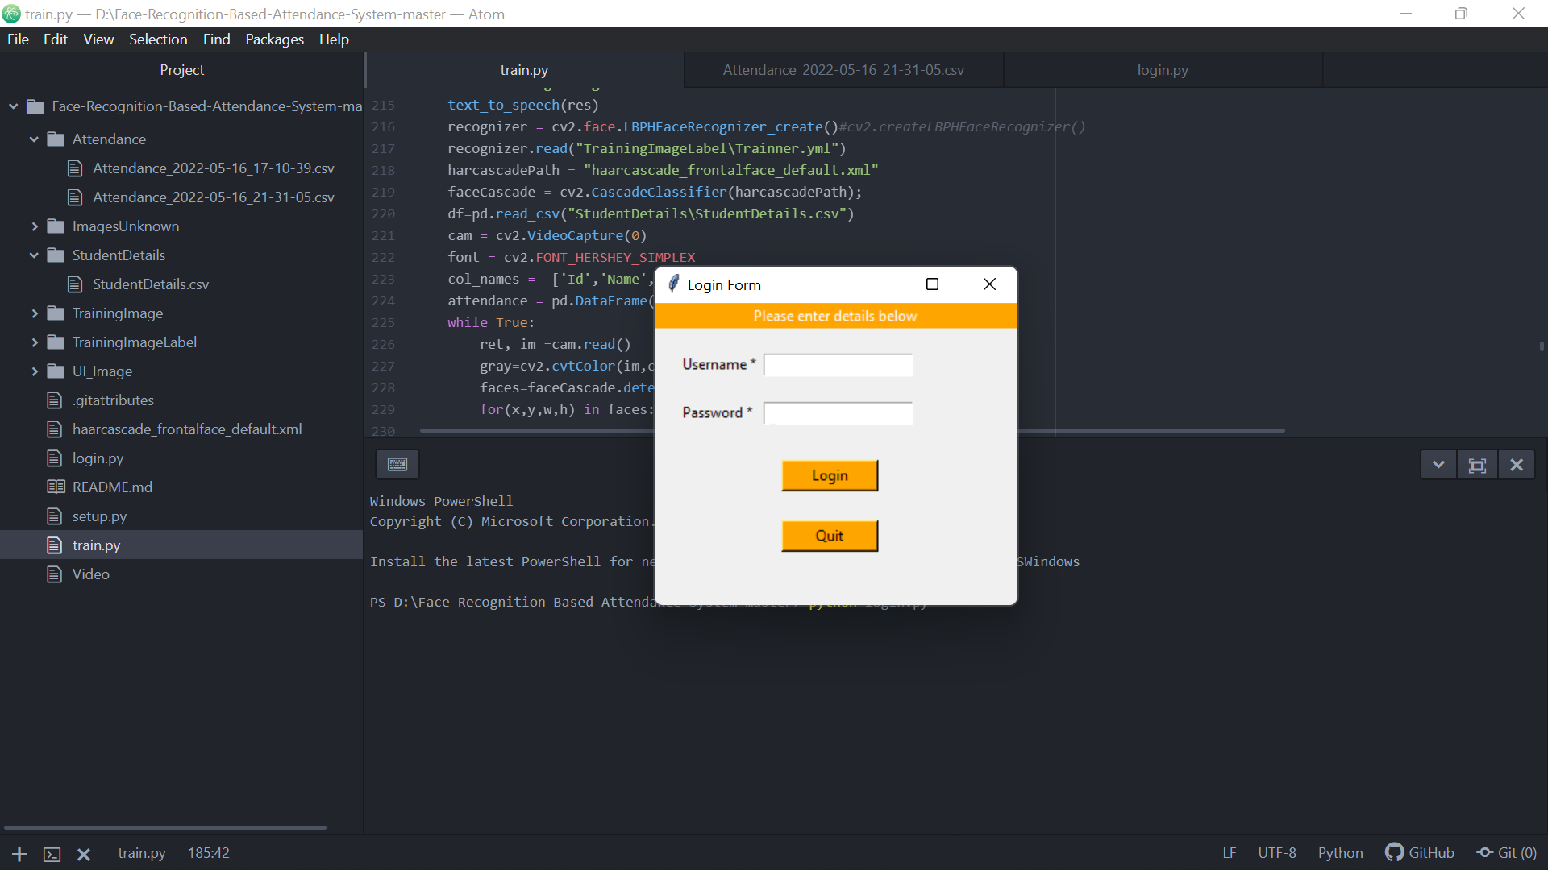
Login Page -
What is the purpose of login form?
A Login form is used to enter authentication credentials to access a restricted page or form. The login form contains a field for the username and another for the password. When the login form is submitted its underlying code checks that the credentials are authentic, giving the user can access the restricted page.
Which method is used with login form?
For login request we should use POST method. Because our login data is secure which needs security. When use POST method the data is sent to server in a bundle. But in GET method data is sent to the server followed by the url like append with url request which will be seen to everyone.

Slide 4
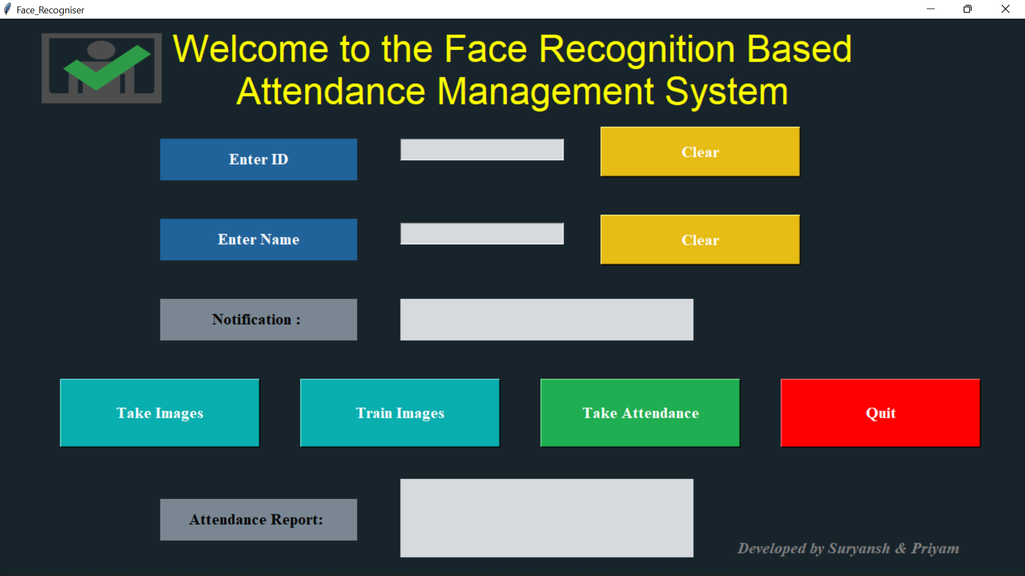
GUI of Our Model –
We have designed our interface by using a frontend designing module of Python named Tkinter.
Reason behind using this is its simplicity to use and high performing features and is also easy to integrate with other modules.

Slide 5
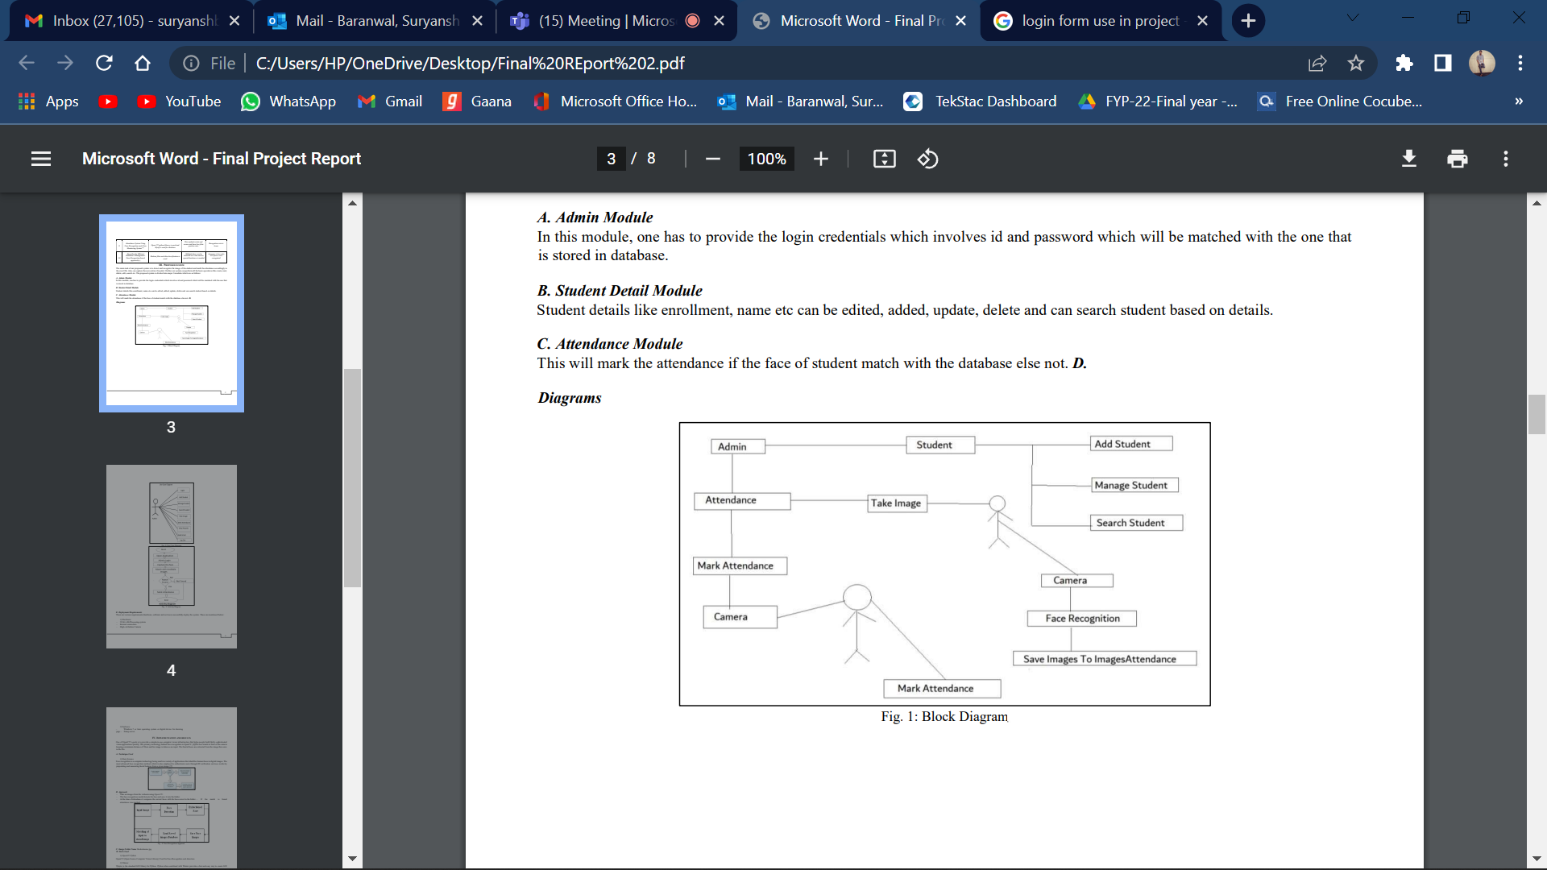
Proposed System -
The main task of our proposed system is to detect and recognize the image of the student and mark the attendance accordingly in the excel file. Also can capture the new entries if needed. Further our system can perform all the basic operations like create, read, delete, edit, search etc.
The proposed system is divided into major 3 modules which are as follows:
A. Admin Module In this module, one has to provide the login credentials which involves id and password which will be matched with the one that is stored in database.
B. Student Detail Module Student details like enrolment , name etc can be edited, added, update, delete and can search student based on details.
C. Attendance Module This will mark the attendance if the face of student match with the database else not.

Slide 6
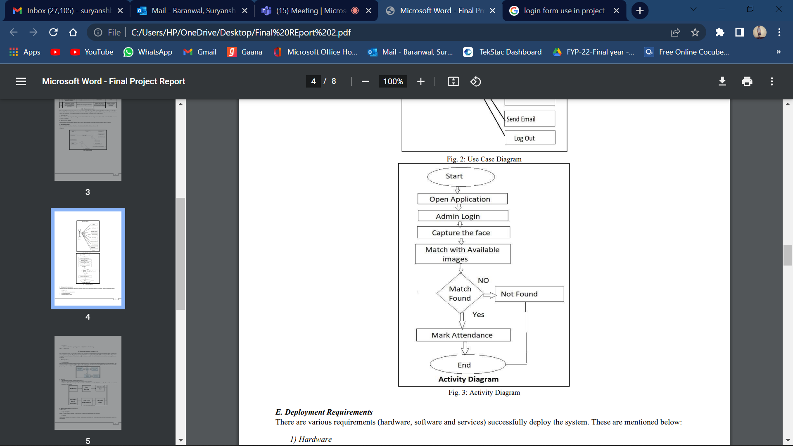
Work Flow -
Face recognition is a computer technology being used in a variety of applications that identifies human faces in digital images. The most advanced face recognition method, which is also employed to authenticate users through ID verification services, works by pinpointing and measuring facial features from a given image.
One of OpenCV’s goals is to provide a simple-to-use computer vision infrastructure that helps people build fairly sophisticated vision applications quickly. The primary technology behind Face recognition is OpenCV . The user stands in front of the camera keeping a minimum distance of 50cm and his image is taken as an input. The frontal faces are extracted from the image then save to the file.

Slide 7
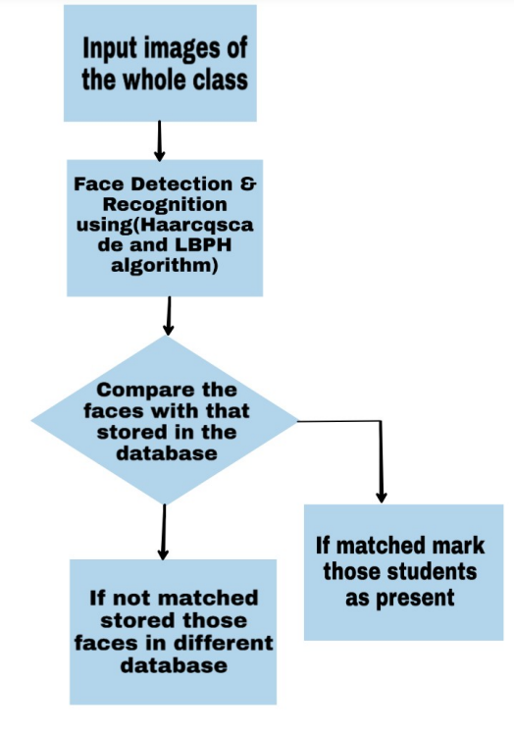
Approach -
– Take an images from the webcam using Open CV.
– The face recognition model detects the face and save it into the folder.
– At the time of attendance it compares the current faces with the faces saved in the folder. – If the match is found attendance was marked.
In this approach, a face recognition based automated attendance system is thoroughly described. The proposed approach provides a method to identify the individuals by comparing their input image obtained from image in folder. From this model we can recognize the faces of students and can mark their attendance automatically in real time without human intervention. The feasibility of the model can be increased if a cloud can be hired to store details.

Slide 8
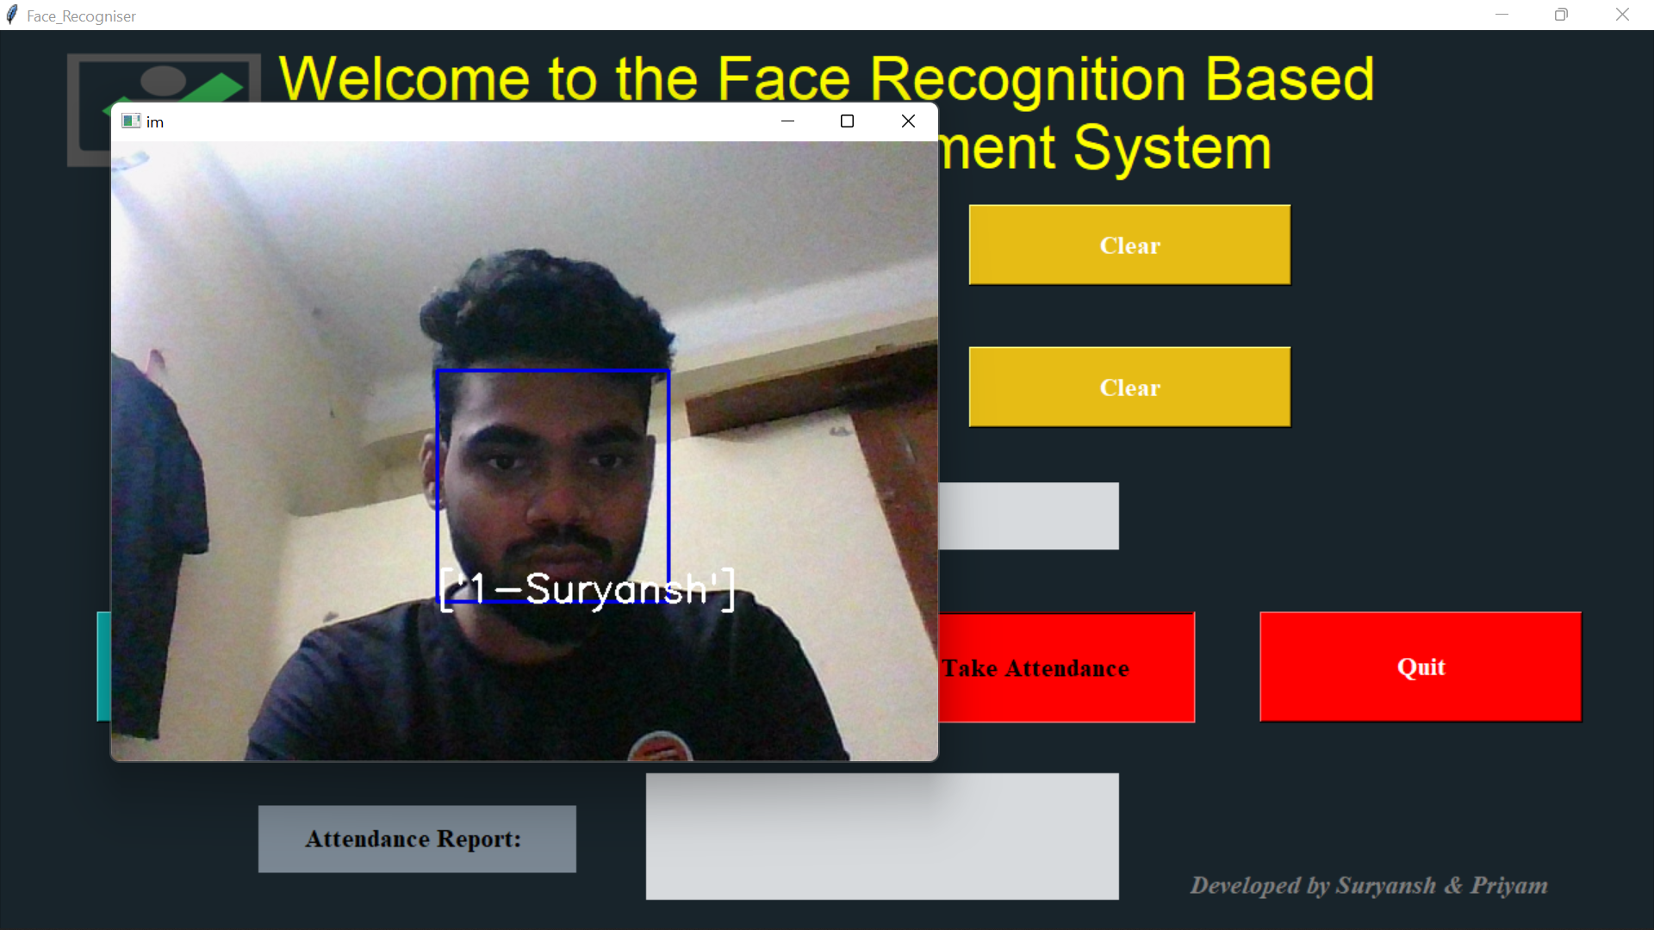
Take Image -
Steps for Face Recognition
– First, look at a picture and find all the faces in it.
– Second, focus on each face and be able to understand that even if a face is turned in a weird direction or in bad lighting, it is still the same person.
– Third, be able to pick out unique features of the face that you can use to tell it apart from other people - like how big the eyes are, how long the face is, etc.
– Finally, compare the unique features of that face to all the people you already know to determine the person’s name.

Slide 9
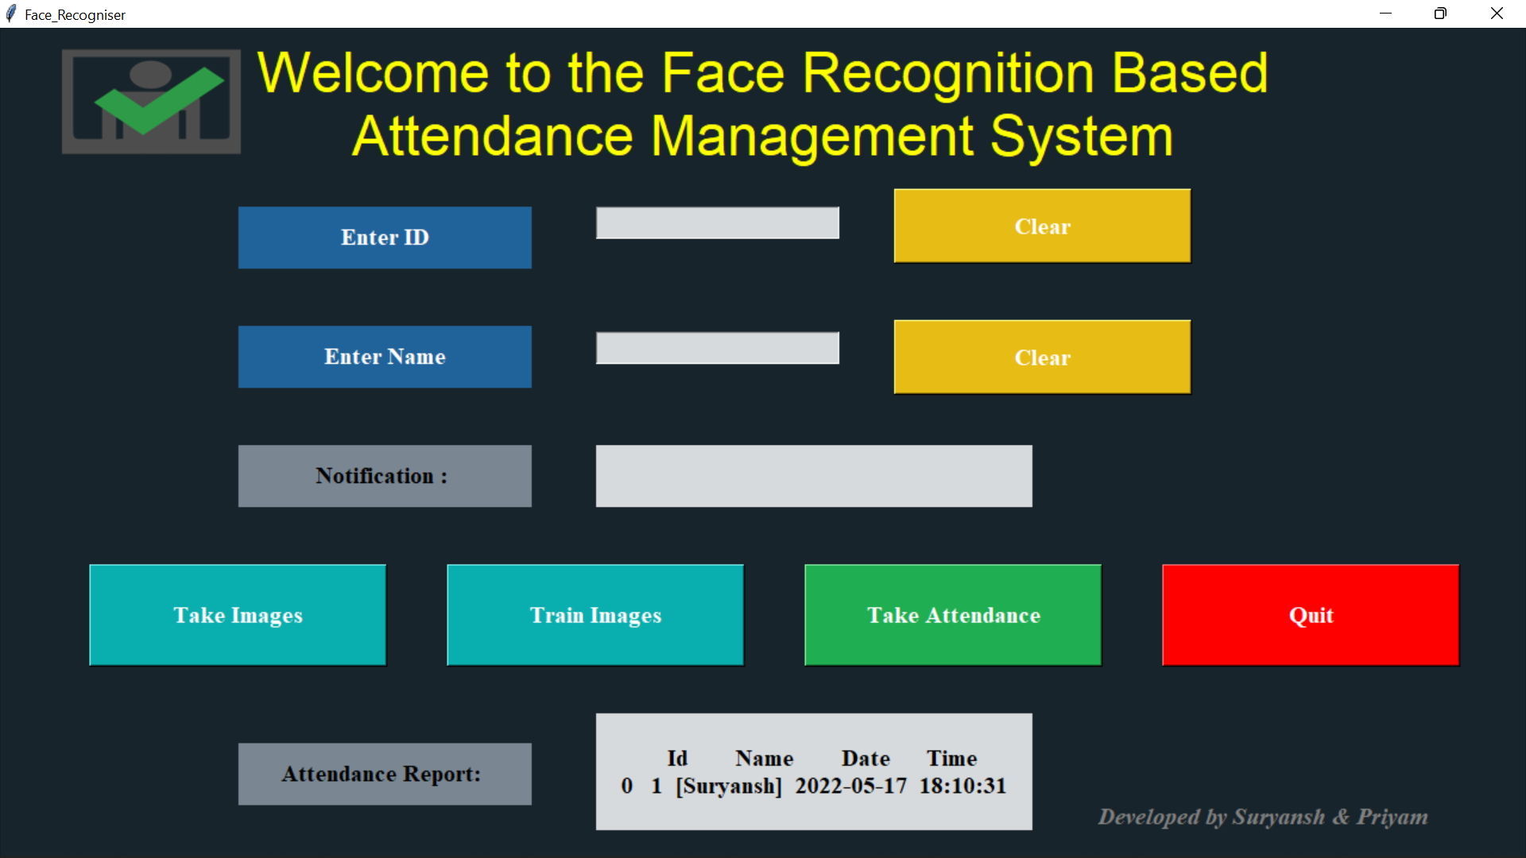
Attendance Report -
As Soon as the Attendance is taken the details are displayed in the Attendance Report Box with the field names including -
Id , Name , Date , Time
In the next step all the above details get saved as a csv file in the project folder itself.
This system has advantage over the traditional system as it saves time and there is no chance of proxy (that is no other student will mark the attendance of his/her friends)

Slide 10
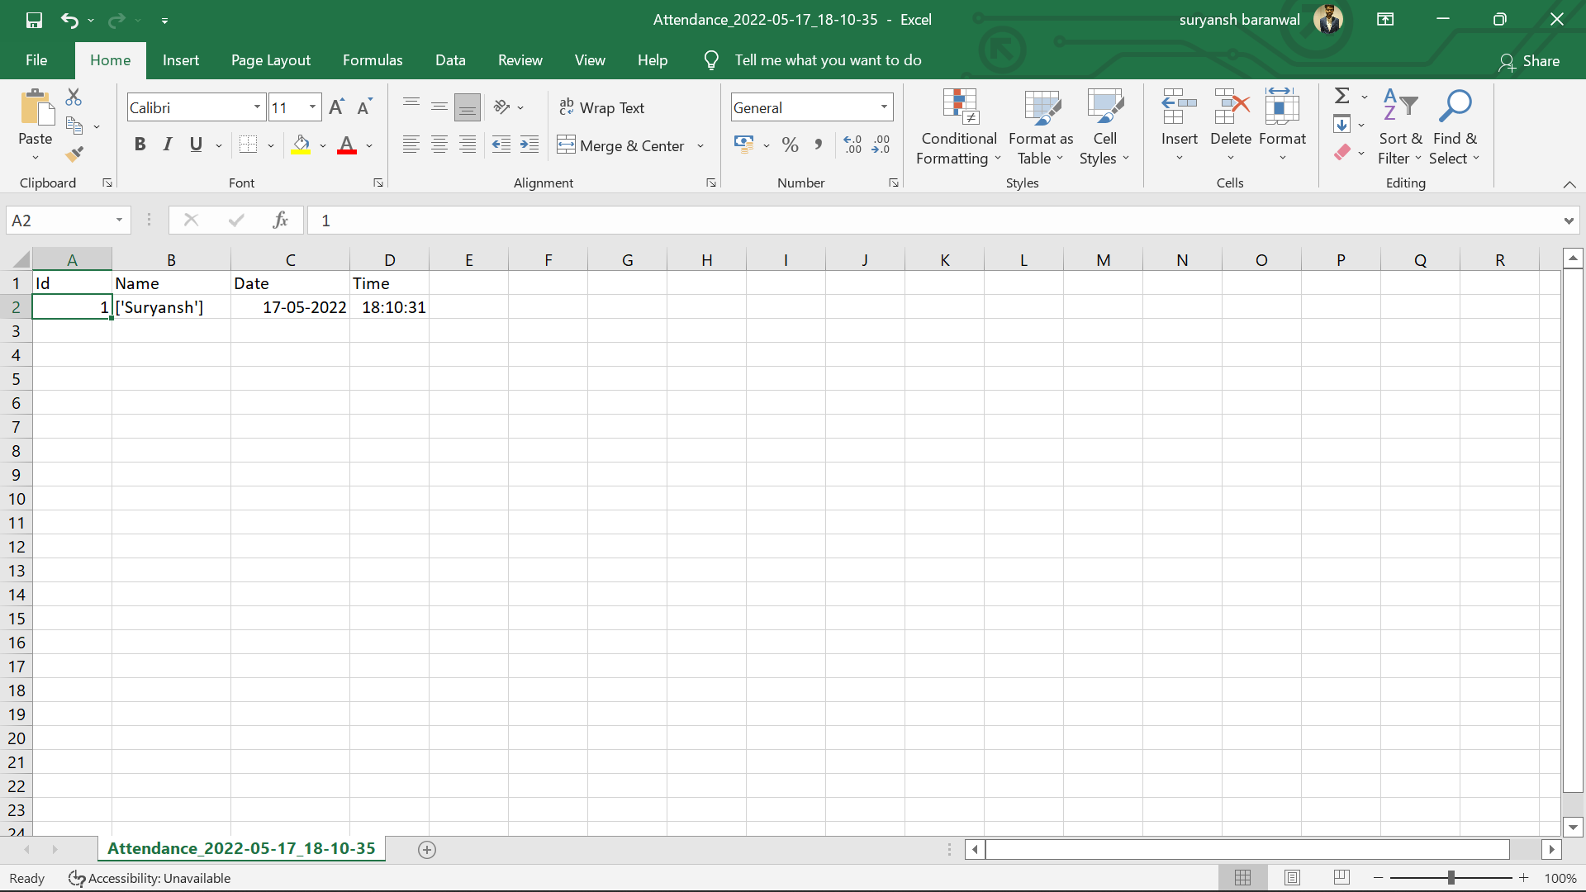
Attendance Report csv file -
The details of the students get automatically stored in a csv file with naming convention including date and time of the attendance taken . This csv file can be easily accessed by the faculty at any given time and time taken is also very less and there are very less chances of any discrepancy or fake attendance.

Slide 11
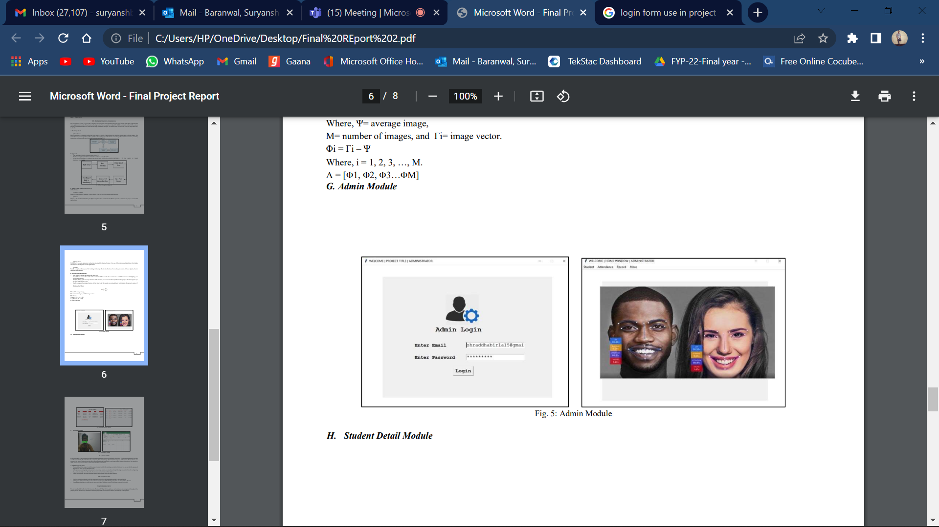
Limitations of our Work -
– The working of this project would become a tedious task for the working on identical twins or we can say that the proposed idea will not work for two identical twins.
– In the system, scanning of genuine person is done using camera, so sometimes it may take large amount of time for configuring the genuine identity due to the lack of server issue or the failure of the database.
– Unable to recognize face with different angles, image quality, size and light intensity.

Slide 12



suryanshb123@gmail.com
priyamgupta731@gmail.com
Suryansh Baranwal - 10400118046
Priyam Gupta - 10400118103

